Slide 1
Introduction to Android

Slide 2
What is Android?
Open source based on modified Linux kernel.
Developed to target mobile devices like:
Smartphone and Tablet
Android TV
Android Auto
Android Thing
Wear OS
Game Console
Digital Camera
Personal Computer

Slide 3
What is Android?
Android was developed by the Open Handset Alliance, led by Google.
Android offers a unified approach to application development for mobile devices which means developers need only develop for Android OS, and their applications should be able to run on different devices powered by Android.
The first version of the Android Software Development Kit (SDK) was released by Google in 2007.

Slide 4
What is Android?
The core Android source code is known as Android Open Source Project (AOSP), and is primarily under the Apache License.
The source code for Android is free available at https://source.android.com/
Notes:
https://source.android.com/

Slide 5
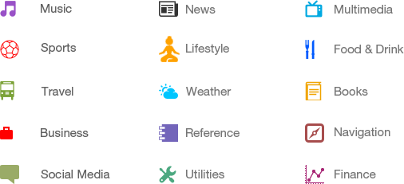
Categories of Android Applications
Notes:
https://source.android.com/

Slide 6
Android Smartphone as a Gadget
Most Android-powered devices have variety of built-in sensors. It includes:
Motion sensors
Environmental conditions sensors
Orientation sensors
Motion sensors
These sensors measure acceleration forces and rotational forces along three axes.
This category includes accelerometers, gravity sensors, gyroscopes, and rotational vector sensors.
Notes:
https://developer.android.com/guide/topics/sensors/sensors_overview

Slide 7
Android Smartphone as a Gadget
Environmental sensors
These sensors measure various environmental parameters, such as ambient air temperature and pressure, illumination, and humidity.
This category includes barometers, photometers, and thermometers.
Position sensors
These sensors measure the physical position of a device.
This category includes orientation sensors and magnetometers

Slide 8
Features of Android OS
Beautiful UI
Android OS basic screen provides a beautiful and intuitive user interface.
Connectivity
GSM/EDGE, IDEN, CDMA, EV-DO, UMTS, Bluetooth, Wi-Fi, LTE, NFC and WiMAX.
Storage
SQLite: A lightweight relational database, is used for data storage purposes.

Slide 9
Features of Android OS
Media support
H.263, H.264, MPEG-4 SP, AMR, AMR-WB, AAC, HE-AAC, AAC 5.1, MP3, MIDI, Ogg Vorbis, WAV, JPEG, PNG, GIF, and BMP
Messaging
SMS and MMS
Web browser
Based on the open-source WebKit layout engine, coupled with Chrome's V8 JavaScript engine supporting HTML5 and CSS3.

Slide 10
Features of Android OS
Multi-touch
Android has native support for multi-touch which was initially made available in handsets such as the HTC Hero.
Multi-tasking
User can jump from one task to another and same time various application can run simultaneously.
Resizable widgets
Widgets are resizable, so users can expand them to show more content or shrink them to save space

Slide 11
Features of Android OS
Multi-Language
Supports single direction and bi-directional text.
GCM
Google Cloud Messaging (GCM) is a service that lets developers send short message data to their users on Android devices, without needing a proprietary sync solution.
Wi-Fi Direct
A technology that lets apps discover and pair directly, over a high-bandwidth peer-to-peer connection.
Android Beam
A popular NFC-based technology that lets users instantly share, just by touching two NFC-enabled phones together.

Slide 12
Platform Architecture
Android is an open source, Linux-based software stack created for a wide array of devices and form factors.
Upcoming diagrams show the major components of the Android platform.
Notes:
https://developer.android.com/guide/platform/

Slide 13
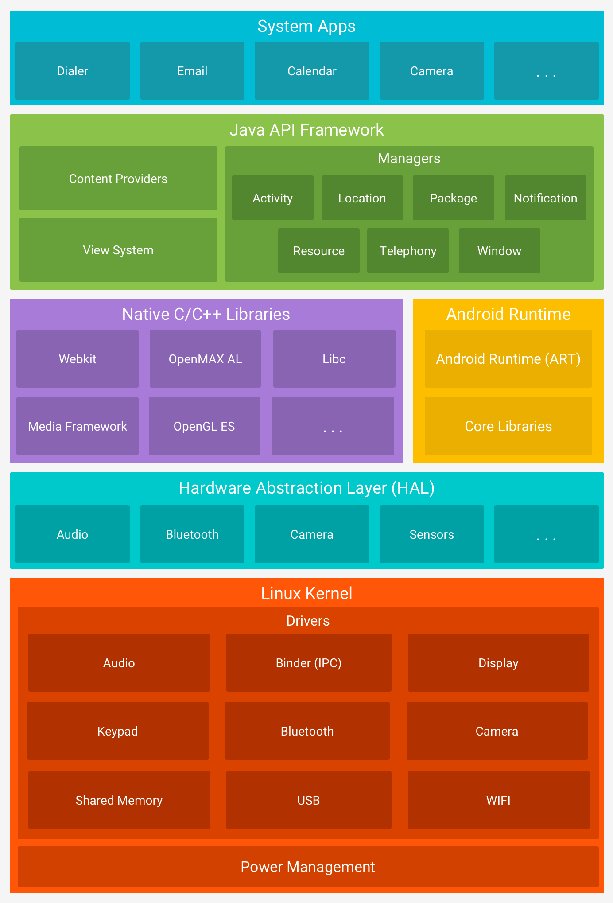
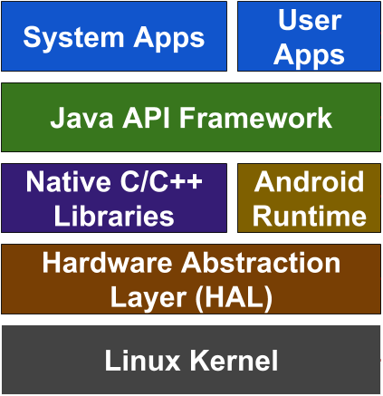
Platform Architecture

Slide 14
Platform Architecture
The Linux Kernel
The foundation of the Android platform is the Linux kernel.
Functionalities such as:
processes and thread management
memory management
device management
low-level memory management.
Gives Android advantages of key security features of Linux.

Slide 15
Platform Architecture
Hardware Abstraction Layer (HAL)
It provides standard interfaces that expose device hardware capabilities to the higher-level Java API framework.
The HAL consists of multiple library modules, each of which implements an interface for a specific type of hardware component.
When a framework API makes a call to access device hardware, the Android system loads the library module for that hardware component.

Slide 16
Platform Architecture
Android Runtime
Each app runs in its own process and with its own instance of the Android Runtime (ART).
ART run multiple virtual machines on low-memory devices by executing DEX format.
Dalvik Executable format (DEX) is a bytecode format designed specially for Android that's optimized for minimal memory footprint.

Slide 17
Platform Architecture
Android Runtime (continues …)
Some of the major features of ART include the following:
Ahead-of-time (AOT) and just-in-time (JIT) compilation.
Optimized garbage collection (GC).
On Android 9 and higher, conversion of an app package's Dalvik Executable format (DEX) files to more compact machine code.
Development and debugging improvements.
It also includes a set of core runtime libraries that provide most of the functionality of the Java programming language.
Notes:
ART and Dalvik: https://source.android.com/devices/tech/dalvik

Slide 18
Platform Architecture
Native C/C++ Libraries
Many core Android system components and services, such as ART and HAL, are built from native code that require native libraries written in C and C++.
The Android platform provides Java framework APIs to expose the functionality of some of these native libraries to apps.

Slide 19
Platform Architecture
Native C/C++ Libraries (continues …)
For example, you can access OpenGL ES through the Android framework’s Java OpenGL API.
If you are developing an app that requires C or C++ code, you can use the Android NDK to access some of these native platform libraries directly from your native code.

Slide 20
Platform Architecture
Java API Framework
The entire feature-set of the Android OS is available to you through APIs written in the Java language.
To create Android apps we simply reuse of core, modular system components and services of the framework, which include the following:

Slide 21
Platform Architecture
Java API Framework (continues)
It includes the following:
A rich and extensible View System you can use to build an app’s UI, including lists, grids, text boxes, buttons, and even an embeddable web browser
A Resource Manager, providing access to non-code resources such as localized strings, graphics, and layout files
A Notification Manager that enables all apps to display custom alerts in the status bar
An Activity Manager that manages the lifecycle of apps and provides a common navigation back stack
Content Providers that enable apps to access data from other apps, such as the Contacts app, or to share their own data

Slide 22
Platform Architecture
System Apps
Android comes with a set of core apps for email, SMS messaging, calendars, internet browsing, contacts, and more.
Apps included with the platform have no special status among the apps the user chooses to install.
i.e. a third-party app can become the user's default web browser, SMS messenger, or even the default keyboard (some exceptions apply, such as the system's Settings app).

Slide 23
Platform Codenames, Versions, API Levels
Code name | Version | API level |  | Code name | Version | API level
(no code name) | 1 | API level 1 |  | Jelly Bean | 4.1.x | API level 16
(no code name) | 1.1 | API level 2 |  | Jelly Bean | 4.2.x | API level 17
Cupcake | 1.5 | API level 3 |  | Jelly Bean | 4.3.x | API level 18
Donut | 1.6 | API level 4 |  | KitKat | 4.4 - 4.4.4 | API level 19
Eclair | 2 | API level 5 |  | Lollipop | 5 | API level 21
Eclair | 2.0.1 | API level 6 |  | Lollipop | 5.1 | API level 22
Eclair | 2.1 | API level 7 |  | Marshmallow | 6 | API level 23
Froyo | 2.2.x | API level 8 |  | Nougat | 7 | API level 24
Gingerbread | 2.3 - 2.3.2 | API level 9 |  | Nougat | 7.1 | API level 25
Gingerbread | 2.3.3 - 2.3.7 | API level 10 |  | Oreo | 8.0.0 | API level 26
Honeycomb | 3 | API level 11 |  | Oreo | 8.1.0 | API level 27
Honeycomb | 3.1 | API level 12 |  | Pie | 9 | API level 28
Honeycomb | 3.2.x | API level 13 |  | Android 10 (Q-Quince Tart) | 10 | API level 29
Ice Cream Sandwich | 4.0.1 - 4.0.2 | API level 14 |  | Android 11 (R-Red Velvet Cake) | 11 | API level 30
Ice Cream Sandwich | 4.0.3 - 4.0.4 | API level 15 |  | Android 12 (S-Snow Cone) | 12 | API level 31

Slide 24
Application Fundamentals
Android apps can be written using Kotlin, Java, and C++ languages.
The Android SDK tools compile your code along with any data and resource files into an APK.
APK is an Android package, which is an archive file with an .apk suffix.
One APK file contains all the contents of an Android app and is the file that Android-powered devices use to install the app.
Notes:
https://developer.android.com/guide/components/fundamentals

Slide 25
Application Fundamentals
Each Android app lives in its own security sandbox, protected by the following Android security features:
The Android operating system is a multi-user Linux system in which each app is a different user.
The system assigns each app a unique Linux user ID.
This ID is used only by the system and is unknown to the app.
The system sets permissions for all the files in an app (folder) so that only the user ID assigned to that app can access them.

Slide 26
Application Fundamentals
Every app runs in its own Linux process.
Each process has its own virtual machine (VM), so an app's code runs in isolation from other apps.
The Android system starts the process when any of the app's components need to be executed.
The Android system shuts down the process when it's no longer needed or when the system must recover memory for other apps.

Slide 27
Application Fundamentals
If the apps are signed with the same certificate it is possible to arrange two apps to share the same Linux user ID.
In that case they are able to access each other's files.
To conserve system resources, apps with the same user ID can also arrange to run in the same Linux process and share the same VM.

Slide 28
Application Fundamentals
Principle of least privilege
Each app has access only to the components that it requires to do its work and no more.
This creates a very secure environment in which an app cannot access parts of the system for which it is not given permission.

Slide 29
App Components
App components are the essential building blocks of an Android app.
Each component is an entry point through which the system or a user can enter your app. Some components depend on others.
These components are loosely coupled by the application manifest file AndroidManifest.xml that describes each component of the application and how they interact

Slide 30
App Components
There are four different types of app components:
Activities
Services
Broadcast receivers
Content providers
Each type serves a distinct purpose and has a distinct lifecycle that defines how the component is created and destroyed.

Slide 31
App Components
1. Activity
An activity is the entry point for interacting with the user. It represents a single screen with a UI.
For example, an email app might have:
one activity that shows a list of new emails
another activity to compose an email
and another activity for reading emails.
Although the activities work together to form a cohesive user experience in the email app, each one is independent of the others.

Slide 32
App Components
1. Activity (continues …)
A different app can start any one of these activities if the email app allows it.
For example, a camera app can start the activity by the email app that composes new mail to allow the user to share a picture.

Slide 33
App Components
1. Activity (continues …)
An activity is implemented as a subclass of Activity class as follows:
public class MainActivity extends Activity {
}
Activity
MyActivity

Slide 34
App Components
2. Service
A service is a general-purpose entry point for keeping an app running in the background for all kinds of reasons.
It is a component that runs in the background to perform long-running operations or to perform work for remote processes.
A service does not provide a user interface.

Slide 35
App Components
2. Service (continues …)
For example:
A service might play music in the background
or it might fetch data over the network without blocking user interaction with an activity.
Another component, such as an activity, can:
start the service and let it run.
or bind to it in order to interact with it.

Slide 36
App Components
2. Service (continues …)
A service is implemented as a subclass of Service class as follows:
public class MyService extends Service {
}
<<abstract>>
Service
MyService

Slide 37
App Components
3. Broadcast Receiver
A broadcast receiver is a component that responds to system-wide broadcast announcements from other applications or from the system.
Each broadcast is delivered as an Intent object.
System broadcast examples:
a broadcast announcing that the screen has turned off, the battery is low, or a picture was captured.
App broadcast example:
to let other apps know that some data has been downloaded to the device and is available for them to use.

Slide 38
App Components
3. Broadcast receiver (continues …)
A broadcast receiver is implemented as a subclass of BroadcastReceiver class and each message is broadcasted as an Intent object.
public class MyReceiver extends BroadcastReceiver {
}
<<abstract>>
BroadcastReceiver
MyBroadcastRecv

Slide 39
App Components
4. Content provider
A content provider manages a shared set of app data that you can store:
in the file system
in a SQLite database
on the web
or on any other persistent storage location that your app can access.
Through the content provider, other apps can query or modify the data if the content provider allows it.

Slide 40
More About App
A unique aspect of the Android system design is that any app can start another app’s component. For example:
if you want the user to capture a photo with the device camera, there's probably another app that does that and your app can use it instead of developing an activity to capture a photo yourself. You don't need to incorporate or even link to the code from the camera app.

Slide 41
More About App
You can simply start the activity in the camera app that captures a photo. When complete, the photo is even returned to your app so you can use it.
To the user, it seems as if the camera is actually a part of your app.

Slide 42
More About App
When the system starts a component, it starts the process for that app (if it's not already running).
For example:
if your app starts the activity in the camera then activity runs in the process that belongs to the camera app, not in your app's process.
Therefore, unlike apps on most other systems, Android apps don't have a single entry point (there's no main() function, for example).

Slide 43
More About App
Because the system runs each app in a separate process with file permissions that restrict access to other apps, your app cannot directly activate a component from another app. However, the Android system can.
To activate a component in another app, deliver a message to the system that specifies your intent to start a particular component.
The system then activates the component for you.

